Slide 1


Credit Card Usage Segmentation
CONFIDENTIAL: The information in this document belongs to Boston Institute of Analytics LLC. Any unauthorized sharing of this material is prohibited and subject to legal action under breach of IP and confidentiality clauses.

Slide 2
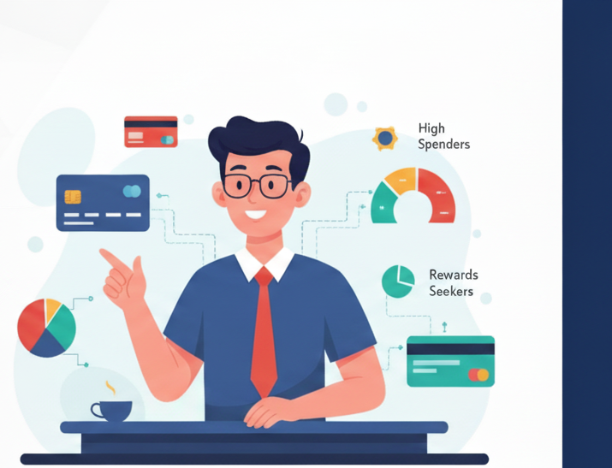
Credit Card Usage Customer Segmentation Using Unsupervised Learning
This project aims to segment credit card customers based on their transaction and payment patterns using unsupervised learning models. By identifying unique customer groups, financial institutions can enhance marketing strategies, improve risk management, and offer personalized financial solutions.
Presented By – Adnan Ilahi
Additionally, a Random Forest Classifier model is implemented to predict cluster membership for new customers.

Slide 3
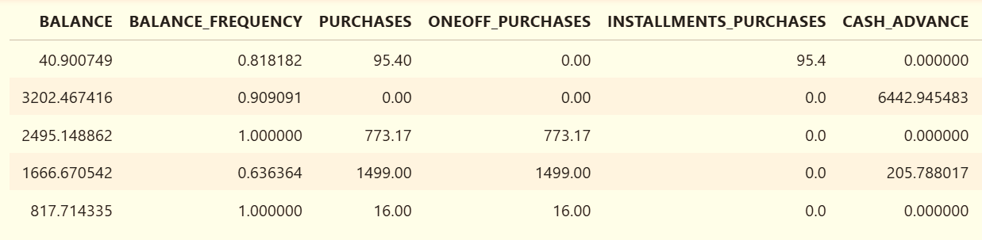
Dataset Overview – Credit Card Usage Data
Missing Values:
CREDIT_LIMIT → 1 missing value
MINIMUM_PAYMENTS → 313 missing values (handled using mean imputation)
Key Variables
BALANCE: Current outstanding balance on the credit card.
PURCHASES: Total amount spent on purchases.
CASH_ADVANCE: Total cash withdrawn using the credit card.
CREDIT_LIMIT: Maximum credit limit assigned to the customer.
PAYMENTS: Total amount paid by the customer.
TENURE: Number of months the account has been active.
The dataset consists of 8,950 customer records and 18 financial features describing their credit card usage behavior. Each record represents a unique customer, including details such as their balance, purchase frequency, cash advances, and payment history.

Slide 4
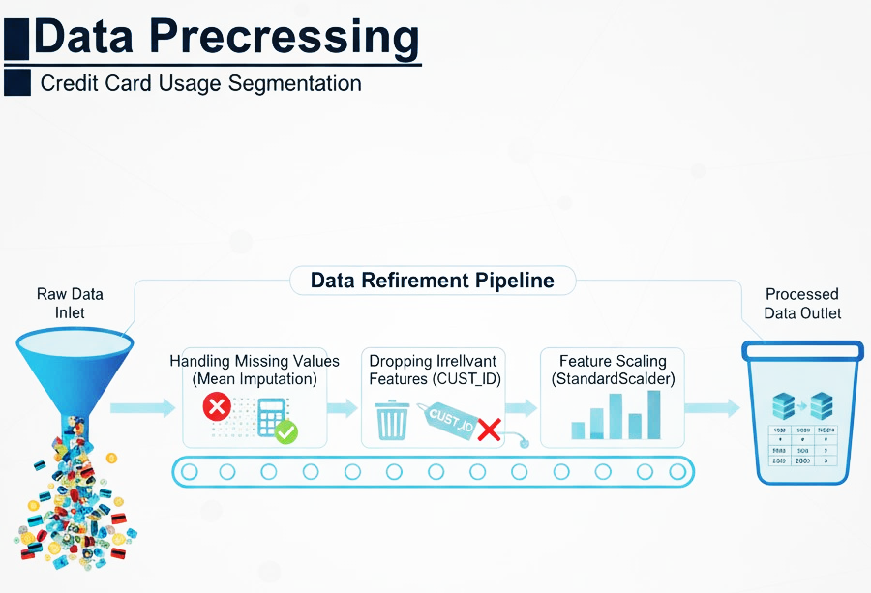

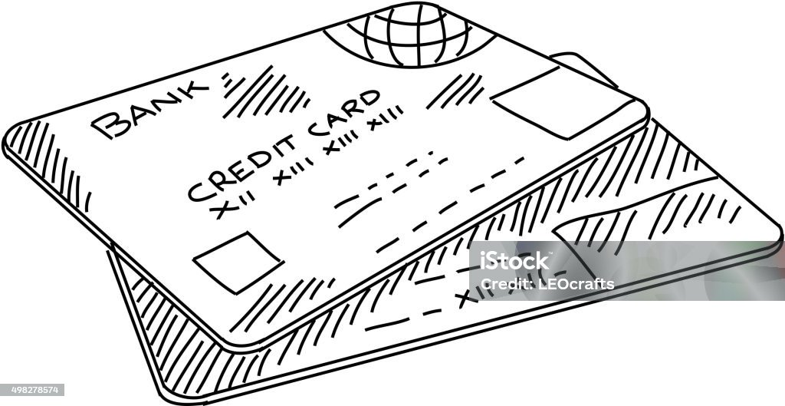

DATA PROCESSING
Data preprocessing was an essential step to ensure data quality and accuracy before applying machine learning. The dataset contained missing and inconsistent values, which were treated using appropriate techniques. Numerical features were standardized to bring all variables to the same scale for better clustering performance.
Key Steps Performed:
Removed duplicate and irrelevant records
Imputed missing values in CREDIT_LIMIT and MINIMUM_PAYMENTS using mean substitution
Dropped non-numerical columns such as CUST_ID
Standardized numerical variables using StandardScaler()
Finalized clean dataset for model training and clustering

Slide 5
Model Building – Unsupervised Learning
Description : In this phase, unsupervised learning algorithms were implemented to segment customers based on their spending and payment behavior. The primary goal was to group similar customers together for better business insights and marketing strategies.
Process Summary:
Selected optimal number of clusters using Elbow Method.
Evaluated clustering performance using Silhouette Score.
Visualized clusters with PCA scatter plots for clear interpretation.
Models Implemented:
K-Means Clustering: Applied to segment customers into optimal clusters using Elbow Method and Silhouette Score.
Agglomerative Clustering: Used to compare results with hierarchical grouping approach.
Dimensionality Reduction (PCA & t-SNE): Implemented for 2D visualization of customer segments.
Result: Identified 4 distinct customer clusters showing clear differences in spending, payments, and credit behavior.

Slide 6
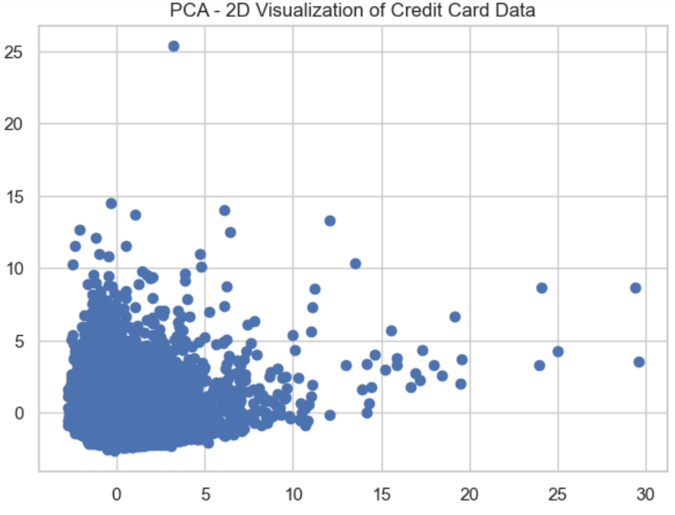
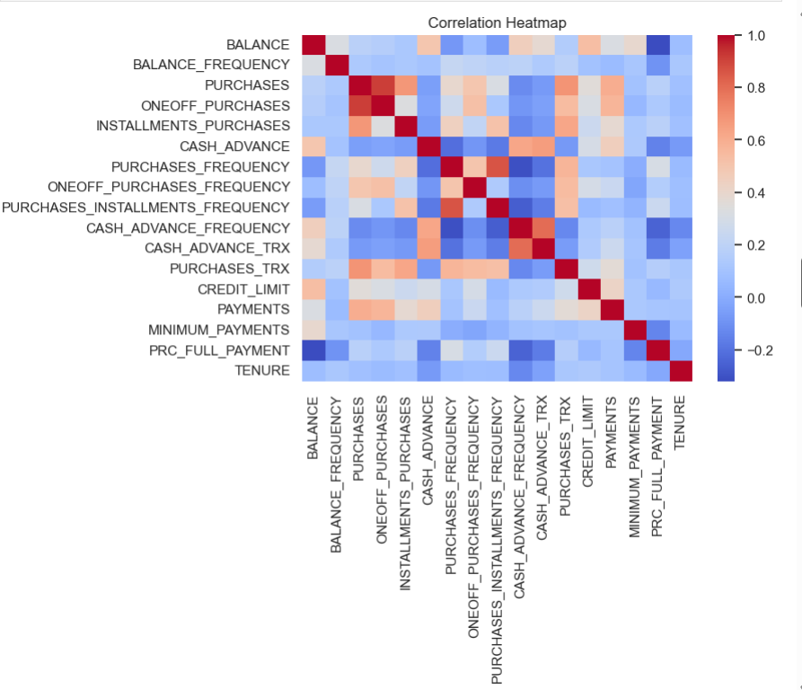
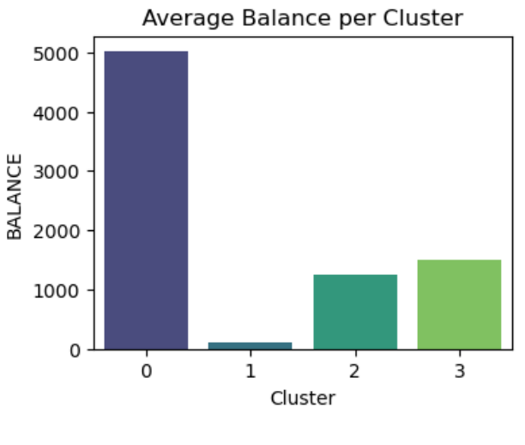
Exploratory Data Analysis (EDA :
EDA helps in understanding data patterns, outliers, and relationships between variables before applying clustering models.
Key Observations from EDA:
Missing values were handled and cleaned.
Data scaling was applied using StandardScaler for uniformity.
Balance, Purchases, and Payments showed right-skewed distributions (most customers have low values, few very high).
PCA revealed that most variance was captured in the first two components, making visualization easier.
Strong Corelations was found between :
Purchase and Payments
Balance and Cash Advance

Slide 7
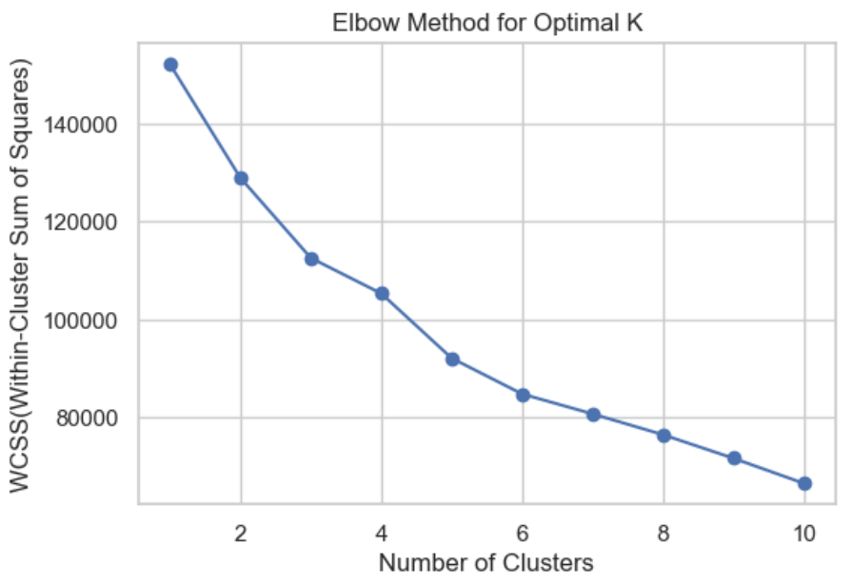
Model Implementation:
Algorithms used:
K-Means Clustering
Agglomerative Clustering
Steps Taken:
Applied K-Means with k = 4 (based on inertia curve).
Evaluated clustering quality using the Silhouette Score.
Visualized clusters using PCA (2D projection).
Determined the optimal number of clusters using the Elbow Method.
Evaluation Metric:
Inertia (Elbow Method)
Silhouette Score
Determined the optimal number of clusters using the Elbow Method.

Slide 8
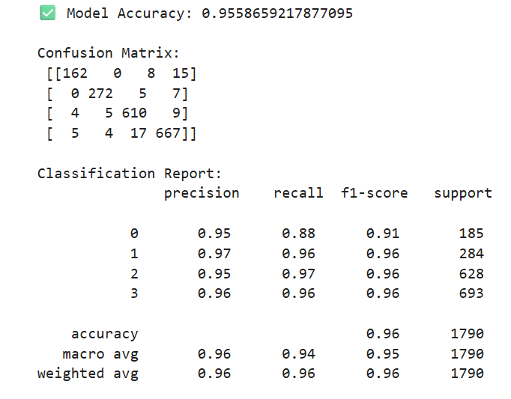
Machine Learning Model
Random Forest Classifier Implementation
Content:
Model Used: Random Forest Classifier
Goal: Predict customer segment based on behavioral features
Insights: Model can help automatically classify new customers into segments
Model Accuracy: ( 0.9558659217877095)

Slide 9
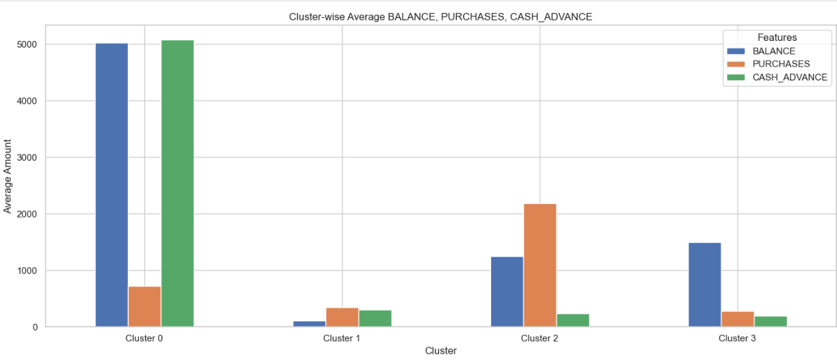
Cluster Analysis and Business Insights
Cluster | Key Characteristics | Business Insights
Cluster 0 | High balance and high cash advance | Premium customers with high spending power; high revenue potential
Cluster 1 | Low balance, low purchases | Low-value customers; focus on engagement campaigns
Cluster 2 | Moderate balance and purchases | Balanced customers; maintain retention strategies
Cluster 3 | High balance, moderate cash advance | High-risk/high-profit customers; offer targeted financial products
Observations:
Clusters 0 & 3 show higher average balance, making them important for marketing and credit offers.
Cluster 1 customers need promotional strategies to increase usage.
Cluster 2 is stable — ideal for long-term retention programs.

Slide 10
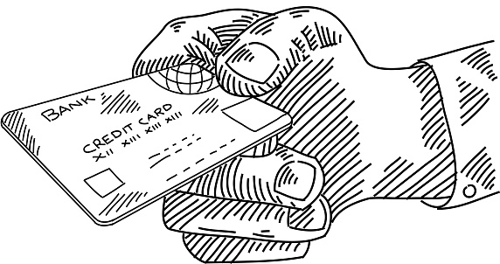
Conclusion
Unsupervised learning models successfully segmented credit card customers into 4 distinct clusters.
Deep analysis revealed significant patterns in spending behavior, balance-to-credit usage, and payment trends across the segments.
The insights derived from these clusters provide a clear roadmap for the bank to enhance marketing strategies, optimize risk management, and boost customer retention.
Conclusion and Recommendation
Business Recommendations
Targeted Marketing: Offer personalized promotions and premium products to high-value clusters (Cluster 0 & 3) to maximize revenue.
Customer Engagement: Re-engage the low-activity cluster (Cluster 1) with targeted rewards, cashback incentives, and educational content on card benefits.
Risk Management: Proactively monitor customers with high cash advance usage to mitigate potential credit risk with tailored credit limit adjustments.
Retention Programs: Nurture the balanced, consistent customers (Cluster 2) through loyalty programs and exclusive benefits to ensure long-term loyalty.

Slide 11
Thank You!
for your time and attention.” Open to questions and feedback.
CONFIDENTIAL: The information in this document belongs to Boston Institute of Analytics LLC. Any unauthorized sharing of this material is prohibited and subject to legal action under breach of IP and confidentiality clauses.

